Slide 1
What Spiritual-Mindedness Is and How It Shows Itself
Romans 8:5-6
A Study on John Owen’s Book ‘Spiritual-Mindedness’
Lesson 2 (Chapter 2)

Slide 2
Scripture Focus
Colossians 3:1-2
If then you were raised with Christ,
seek those things which are above, where Christ is, sitting at the right hand of God.
Set your mind on things above, not on things on the earth. For you died, and your life is hidden with Christ in God. When Christ who is our life appears, then you also will appear with Him in glory.

Slide 3
What Spiritual-Mindedness Is and How It Shows Itself
Our thoughts reveal our true nature
The difference between natural and spiritual thoughts
The role of spiritual spring within believers
The importance of meditation on spiritual things
The danger of superficial religious activity
Proverbs 23:7 For as he thinks in his heart, so is he.

Slide 4
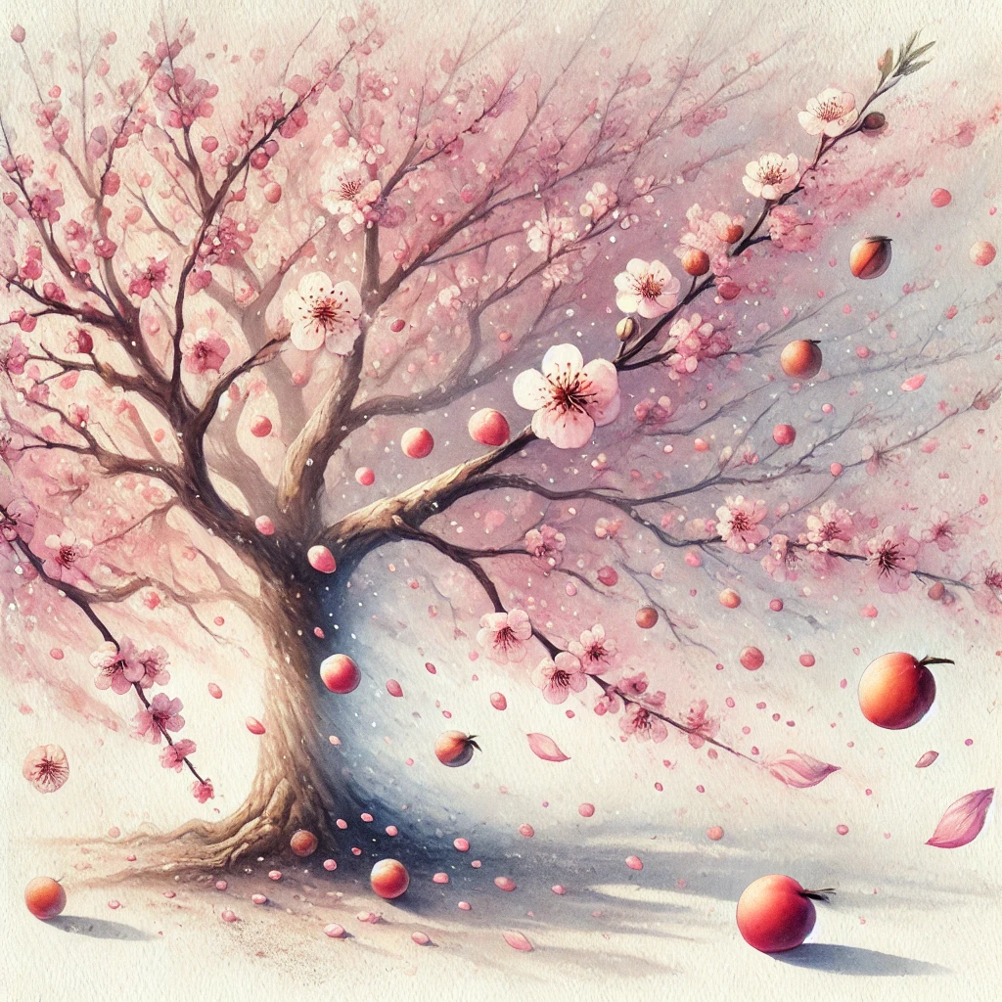
Our Thoughts Reveal Our True Nature
Like blossoms on a tree, our thoughts reveal what we truly are:
Most thoughts may come to nothing
But all actions (fruit), good or bad, come from thoughts
The heart's treasure determines its thoughts
Key Scriptures:
"As a man thinks in his heart, so is he" (Proverbs 23:7)
"A good man out of the good treasure of his heart brings forth good things" (Matthew 12:35)

Slide 5

Natural vs Spiritual Thoughts
Natural Thoughts
Spiritual Thoughts
Forced by duty
Occasional and temporary
Driven by external pressure
Flow naturally from within
Constant and consistent
Driven by inner delight
Key Scripture:
"The water that I shall give him will become in him a fountain of water springing up into everlasting life" (John 4:14)

Slide 6
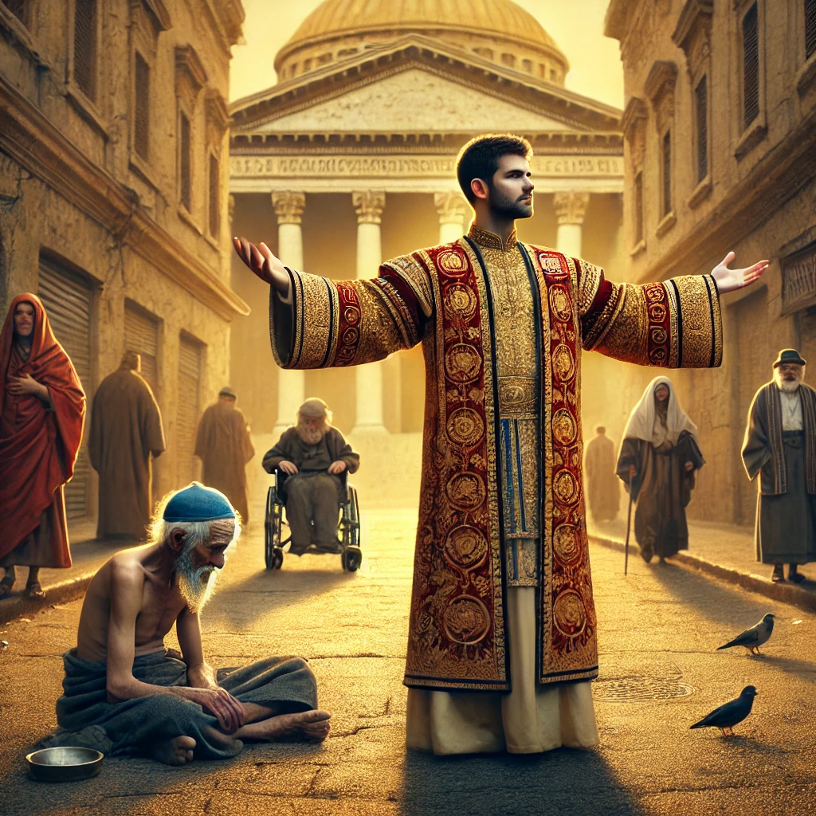
Warning Against Superficial Religion
Many deceive themselves through:
Merely hearing without believing
Assenting to truth without application
Religious duties without heart change
Key Scriptures:
"These people draw near with their mouths and honor Me with their lips, but have removed their hearts far from Me" (Isaiah 29:13)
"Be doers of the word, and not hearers only, deceiving yourselves" (James 1:22)

Slide 7
Discussion Questions
How much of your thought life is on Heavenly things other than Sunday
What dominates your prayers?
Earthly things (Health, Finances, Security, Safety, Success, Family)
Heavenly things (Faith, Knowledge, Hope, God’s Kingdom & Glory, Church)
How can you tell the difference between Spiritual thoughts and externally provoked Spiritual thoughts?
How can we cultivate a deeper delight in heavenly things?

Slide 8
Application & Reflection
Meditate daily on Colossians 3:1-2
Take the week to pray only for Spiritual Blessings
Love and Discernment
Philippians 1:9-10 that your love may abound still more and more in knowledge and all discernment, that you may approve the things that are excellent, that you may be sincere and without offense till the day of Christ,
Glory to God
Philippians 1:20-21 according to my earnest expectation and hope that in nothing I shall be ashamed, but with all boldness, as always, so now also Christ will be magnified in my body, whether by life or by death. For to me, to live is Christ, and to die is gain.
Equipping and Guiding
Ephesians 2:10 For we are His workmanship, created in Christ Jesus for good works, which God prepared beforehand that we should walk in them.
Colossians 3:1 If then you were raised with Christ, seek those things which are above, where Christ is, sitting at the right hand of God."

