Slide 1

Should I participate in Politics?
Hard Questions for Christians

Slide 2
How involved should a Christian be in Government?
What are God’s Instructions to Rulers?
What is the Government’s role in God’s Plan?
What Involvement in politics was expected in Biblical Times?
What is the Christian’s primary role in Society?
What happens when Government opposes God?
What Hope should we put in Government?

Slide 3
Instructions regarding the King
Deuteronomy 17:14-20 “When you come to the land which the LORD your God is giving you, and possess it and dwell in it, and say, I will set a king over me like all the nations that are around me,’ ¹⁵ you shall surely set a king over you whom the LORD your God chooses; one from among your brethren you shall set as king over you; you may not set a foreigner over you, who is not your brother. ¹⁶ But he shall not multiply horses for himself, nor cause the people to return to Egypt to multiply horses, for the LORD has said to you, You shall not return that way again.’ ¹⁷ Neither shall he multiply wives for himself, lest his heart turn away; nor shall he greatly multiply silver and gold for himself.
¹⁸ “Also it shall be, when he sits on the throne of his kingdom, that he shall write for himself a copy of this law in a book, from the one before the priests, the Levites. ¹⁹ And it shall be with him, and he shall read it all the days of his life, that he may learn to fear the LORD his God and be careful to observe all the words of this law and these statutes, ²⁰ that his heart may not be lifted above his brethren, that he may not turn aside from the commandment to the right hand or to the left, and that he may prolong his days in his kingdom, he and his children in the midst of Israel.
Notes:
King Responsibilities:
Chosen by God
Not enriching himself
Study God’s Law and Fear the Lord
King’s Objectives
Humility
Obedience
Promote the General Welfare

Slide 4
Government as God’s Providence
Main Point:
Government is an instrument of God’s providential rule.
Supporting Scriptures:
Romans 13:1-2 – 'There is no authority except from God, and those that exist have been instituted by God.'
Daniel 2:21 – 'He changes times and seasons; He removes kings and sets up kings.'
Quote:
‘The magistrate’s authority is derived from God, whose minister he is.’ – John Calvin, Institutes IV.20.4
Notes:
Why does a given government rise up?
From whom do they receive authority? God alone.
Does that include only what we would call “Good” governments?
So How should a Christian respond to government?
Recognize its legitimate authority for governance.

Slide 5
Limited Participation in Biblical Times
Main Point:
Christians in Scripture were called to submission, not political activism.
Leadership Roles were Appointed in Israel (and in Rome):
  Exodus 18:21-22 Moreover you shall select from all the people able men, such as fear God, men of truth, hating covetousness; and place such over them to be rulers of thousands, rulers of hundreds, rulers of fifties, and rulers of tens. ²² And let them judge the people at all times. Then it will be that every great matter they shall bring to you, but every small matter they themselves shall judge.
Instructions to the Church:
  1 Peter 2:13-17 – 'Be subject for the Lord's sake to every human institution.'
  Titus 3:1 – 'Remind them to be submissive to rulers and authorities, to be obedient.'
  Micah 6:8 – 'Do justice, love kindness, and walk humbly with your God.'
  Matthew 22:21 – 'Render to Caesar the things that are Caesar’s, and to God the things that are God’s.'
Notes:
Q: Would there have been an expectation in Biblical times that a Christian could wield political influence?
NO. That would be the exception, not the rule.
Q: What influence would be expected in Biblical times?
Moral and ethical societal standards.

Slide 6
Christians as Salt and Light
Main Point:
Influence society through moral integrity and witness.
Supporting Scriptures:
Matthew 5:13-16 – 'You are the light of the world.'
Jeremiah 29:4-7 Thus says the LORD of hosts, the God of Israel, to all who were carried away captive, whom I have caused to be carried away from Jerusalem to Babylon:
⁵ Build houses and dwell in them; plant gardens and eat their fruit. ⁶ Take wives and beget sons and daughters; and take wives for your sons and give your daughters to husbands, so that they may bear sons and daughters—that you may be increased there, and not diminished. ⁷ And seek the peace of the city where I have caused you to be carried away captive, and pray to the LORD for it; for in its peace you will have peace.
Notes:
We are called to thrive and grow where we are placed.
Seek peace of the city … why?
So that we will have peace.

Slide 7
Christians as Salt and Light
Jeremiah 29:10-14 For thus says the LORD: After seventy years are completed at Babylon, I will visit you and perform My good word toward you, and cause you to return to this place. ¹¹ For I know the thoughts that I think toward you, says the LORD, thoughts of peace and not of evil, to give you a future and a hope. ¹² Then you will call upon Me and go and pray to Me, and I will listen to you. ¹³ And you will seek Me and find Me, when you search for Me with all your heart. ¹⁴ I will be found by you, says the LORD, and I will bring you back from your captivity; I will gather you from all the nations and from all the places where I have driven you, says the LORD, and I will bring you to the place from which I cause you to be carried away captive.
Notes:
Why do we seek peace and to thrive?
Because the Lord has promised to redeem us. If we are thrashing and not thriving, who will be left for the Lord to gather?

Slide 8
Governments before God
Psalms 2:1-6 Why do the nations rage,
And the people plot a vain thing?
² The kings of the earth set themselves,
And the rulers take counsel together,
Against the LORD and against His Anointed, saying,
³ “Let us break Their bonds in pieces
And cast away Their cords from us.”
⁴ He who sits in the heavens shall laugh;
The Lord shall hold them in derision.
⁵ Then He shall speak to them in His wrath,
And distress them in His deep displeasure:
⁶ “Yet I have set My King
On My holy hill of Zion.”
Notes:
What does God think of Nations and Governments that oppose Him?
He laughs, holds them in derision and speaks to them in wrath.
He has a plan beyond the Nations. His King in Zion.
What is our responsibility as Christians in light of this Psalm? Remember who is King, and where He has placed Authority and Power and the Future.

Slide 9
What Hope should we put in Government?
Main Point:
Avoid placing ultimate hope in politics.
Supporting Scriptures:
Psalm 146:3 – 'Put not your trust in princes.'
Isaiah 31:1 – 'Woe to those who go down to Egypt for help... but do not look to the Holy One of Israel.'
Jeremiah 17:5 Cursed is the man who trusts in man, And makes flesh his strength, Whose heart departs from the LORD.
Psalms 118:8-9 It is better to trust in the LORD, Than to put confidence in man. It is better to trust in the LORD Than to put confidence in princes.
Quote:
‘The Christian’s hope is not in any earthly government, but in the kingdom of Christ.’ – Francis Schaeffer

Slide 10
Jesus on Government
Matthew 22:21 - 'Render to Caesar the things that are Caesar’s, and to God the things that are God’s.’
Matthew 17:24-27 - 'When they came to Capernaum, the collectors of the two-drachma tax went up to Peter and said, “Does your teacher not pay the tax?” He said, “Yes.”’
Matthew 23 - 'Woe to you, scribes and Pharisees, hypocrites! For you tithe mint and dill and cumin, and have neglected the weightier matters of the law: justice and mercy and faithfulness.’
Matthew 5:17-19 Do not think that I came to destroy the Law or the Prophets. I did not come to destroy but to fulfill. ¹⁸ For assuredly, I say to you, till heaven and earth pass away, one jot or one tittle will by no means pass from the law till all is fulfilled. ¹⁹ Whoever therefore breaks one of the least of these commandments, and teaches men so, shall be called least in the kingdom of heaven; but whoever does and teaches them, he shall be called great in the kingdom of heaven.
Matthew 6:33 - 'But seek first the kingdom of God and His righteousness, and all these things will be added to you.’
John 18:36 - 'My kingdom is not of this world. If my kingdom were of this world, my servants would have been fighting.’
Matthew 20:25-28 - 'Whoever would be great among you must be your servant.’
1 Timothy 2:1-2 - 'I urge that supplications, prayers, intercessions, and thanksgivings be made for all people, for kings and all who are in high positions.’
Notes:
Acknowledge Government Legitimacy (pay your taxes)
Take your Moral Stand
Seek God’s Kingdom First
Don’t try to conquer this world.
Serve rather than Lead
Pray for Governors

Slide 11
Conclusion – Faithful Stewardship of our Time
Exercise extreme caution, humility and integrity in politics and activism
  Governments are legitimate, even if you don’t like them
  Don’t despair over Politics
    God is on his Throne
    We are citizens of Heaven
    We are in God’s perfect Kingdom, and can be at peace
  Stand with God’s Law
    God’s Law is Truth and stands for all time
    We seek God’s approval, not Men’s
  The Church holds the Keys to the Kingdom – These should be our priority
    Preaching
    Baptism
    Lord’s Table
‘Our political engagement must always reflect our primary allegiance to Christ.’ – Oliver O’Donovan, The Desire of the Nations

Slide 12
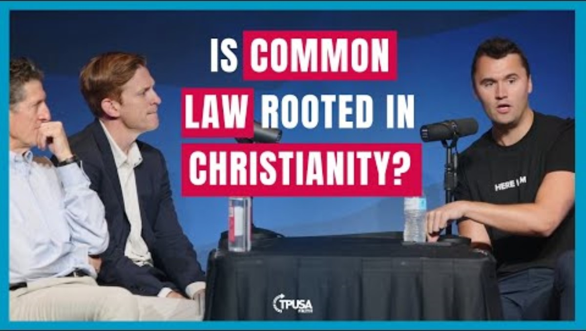
Is the US Built on Christian Principles?

